Slide 1
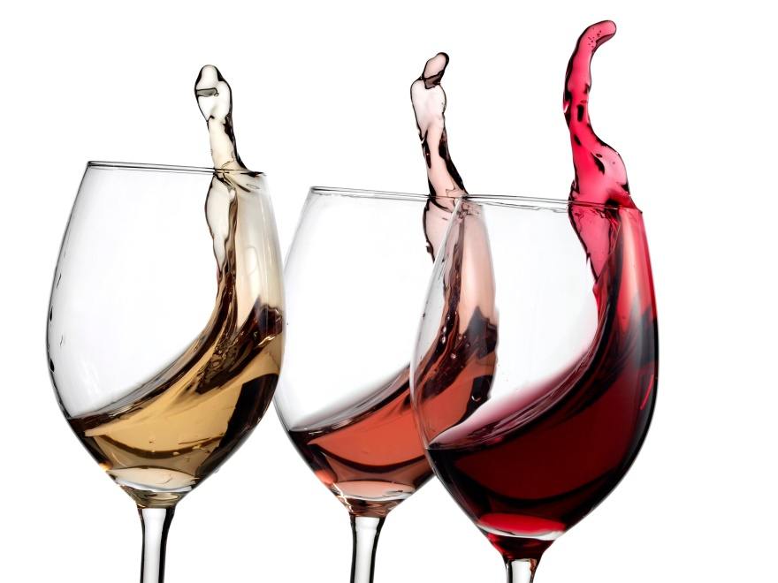
Wines: how can they contribute to the revenues of F&B outlets

Slide 2
Agenda
Wines & how they can contribute to the F&B revenues
Wine appreciation along with food pairing
Q & A
Interaction with wine companies

Slide 3
Points to think about
Why sell wines ?
What creates a successful wine selling environment ?
Revenues – what needs to be considered while selling wines
What can you do to create a success story with wines?

Slide 4
What is wine?
A beverage made of the fermented juice of any of various kinds of grapes, usually containing from 10 to 15 percent alcohol by volume.
Fortified wines contain higher levels of alcohol.

Slide 5
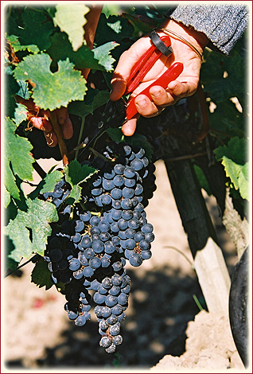
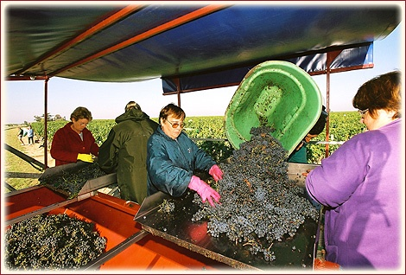
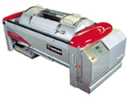
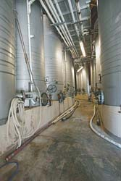
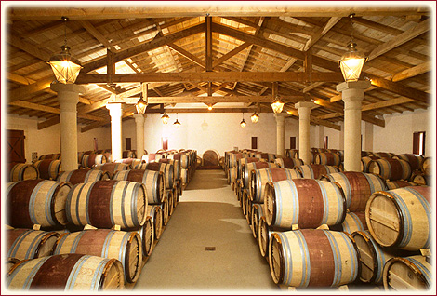
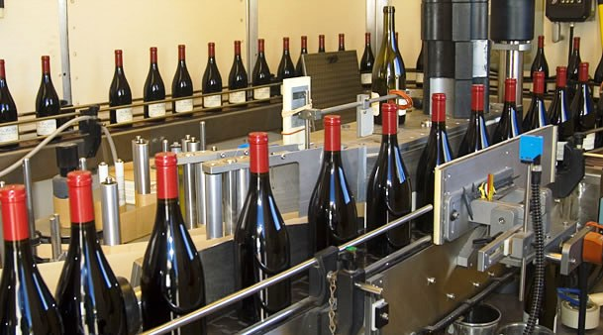
How is wine made?
Grape picking
Sorting
Crushing
Fermentation
Ageing
Bottling

Slide 6

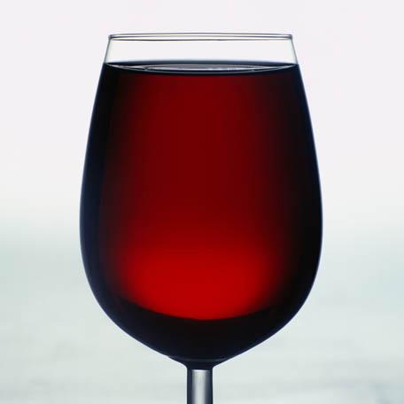
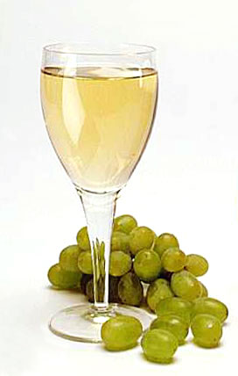
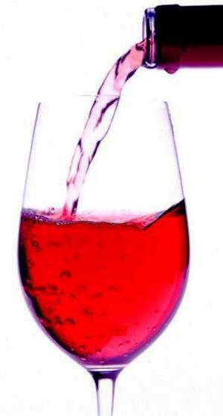
Types of wines
Still wines
  Red
  White
  Rose
Sparkling wines
  White
  Rose
Dessert wines
Fortified wines
  Sherry
  Port

Slide 7
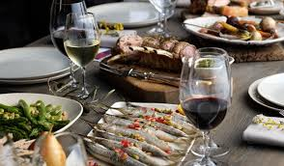
Why sell wines?
A sign of sophistication
Increases food sales

Slide 8
A wine success story depends on…
Suitable products
Attractive price points
Attention to service
Promotions
Regular Training sessions

Slide 9
Product selection
First and foremost – quality
Introduce new products regularly
Include in combos
Select wines in smaller packaging or by the glass
Specialise in certain kinds of wines (origin, grape varieties, etc.)

Slide 10

Pricing matters a lot
Coefficient or fixed margins?
The right hand column matters to the customer – especially in Pune! ☺

Slide 11
Service matters too!
The right glassware
The right temperatures
Storage of the bottles served by the glass
How about a doggy bag for wines ?
What do you suggest to your customer ?

Slide 12
Promotions
A well designed wine list
Creating the suitable ambiance for special promotions
Promotion campaigns by producers

Slide 13
Trainings
Owners and managers of the establishment
Wait staff
Hotel Management schools
Distributors

Slide 14
Our Services
Wine Menu Consulting & Planning
  Food & Wine Pairing: Looking for a perfect match for your restaurant’s menu? Trust us with the match making.
  Prepare a unique wine list which works with your restaurant’s food menu.
Customized Wine Trainings
  Comprehensive trainings with modules on Wine Service, Types, Origins, Labels and much more.
  Focused training to arm food & beverage professionals with accurate and up-to-date, theoretical and practical knowledge of wines, service and wines as a mode of revenue generation.

Slide 15
Training Modules
Introduction to the various grape varietals
Focused Training around Wine Regions
Wine Service & points to remember during wine service.
Wine & Food Pairing
How to sell & upsell wines
We also customize modules based on the needs of your organization.
Get in touch for more details.

Slide 16
Wine 101
Part 1: What is wine?
How wine is made, how to read a wine label, and characteristics of wine such as color and appearance, nose, fruit, taste, tannin, balance, length and finish.
Part 2: Grape Varieties
General information about each of the major grape varietals of retail and commercial wine sales. This module also covers the specifics of predominant flavors, aromas and styles. Sparkling and dessert wines are also explored.
Part 3: Wine-Producing Regions
The major wine-producing areas using maps and colorful illustrations. Geographic characteristics and styles are also noted here.
Part 4: Serving Wine
Demonstration of the correct way to open a bottle of wine and/or Champagne. How to serve wine and what is the correct glassware to use, how and why to decant and proper temperatures.
Part 5: Food and wine pairing
Notes:
Wine and Food pairing hidden

Slide 17


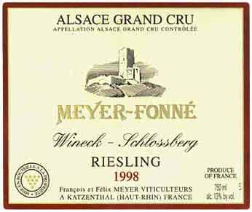
How to read a wine label
European (Old World)
  French
  Italian
  Spanish
  German
  Portuguese
  Austrian
  Hungarian

Slide 18
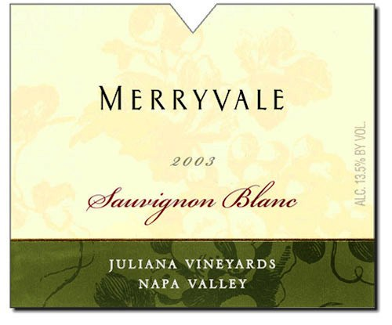


How to read wine labels
New World wines
  Californian
  Australian
  New Zealand
  Chile
  Argentina
  South Africa
  India

Slide 19
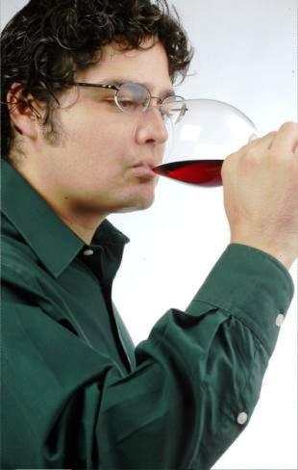
How to taste a wine
Visual Examination
    Colour, clarity, brilliance, age
Olfactory examination
    Aromas, defects
Gustatory examination
    Flavours, defects, age, tannins, balance, length, finish

Slide 20
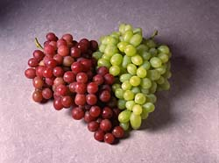
Commonly Known Grape Varieties
Reds
  Cabernet Sauvignon
  Cabernet Franc
  Grenache
  Malbec
  Merlot
  Pinot Noir
  Sangiovese
  Syrah / Shiraz
  Tempranillo
  Zinfandel
Whites
  Chardonnay
  Chenin Blanc
  Gewurztraminer
  Muscat
  Pinot Blanc
  Pinot Gris
  Riesling
  Sauvignon Blanc
  Semillon
  Verdelho
  Viognier

Slide 21
Things to remember
Temperature of service
How to open a bottle?
  Still wine
  Sparkling wine
How and why to decant a wine?

Slide 22
Thank you for joining us!

